Slide 2
Sources of Funds Held in Trust
Multi-donor trust fund
Funds amassed from different domestic and international sources, mechanisms, facilities, and donors
Funds will be held and purposed to target specific stages and activities involved in the relocation process (as per SOP)
Trust will benefit from applicable domestic revenue-raising mechanisms (taxes, levies, as required)
Exempt from income tax (section 9 of the Trust Fund Act)
The average rate of sea level in the southwestern Pacific is 2-3 times the global average
76% of Fiji’s population lives within 5km of the coast and 27% within 1km.
6 Communities have been relocated to date,
676 communities have potential to require relocation in the future,
40-50 are of major concern,
17 communities/settlements currently assessed as being ‘high priority’ for relocation as soon as possible.
Direct and Indirect Leveraging and Blending
3% Contribution from Fiji’s Enviroment and Climate Adaptation Levy (ECAL) on specific Goods and Services. Charged at the rate of 5% on the gross annual turnover of a prescribed service
Required Community Contributions / MOUs
On-Budget Government Services Leveraged
Cost-Sharing with NGOs
Direct contributions from Bilateral Partners (Government of New Zealand)

Slide 3
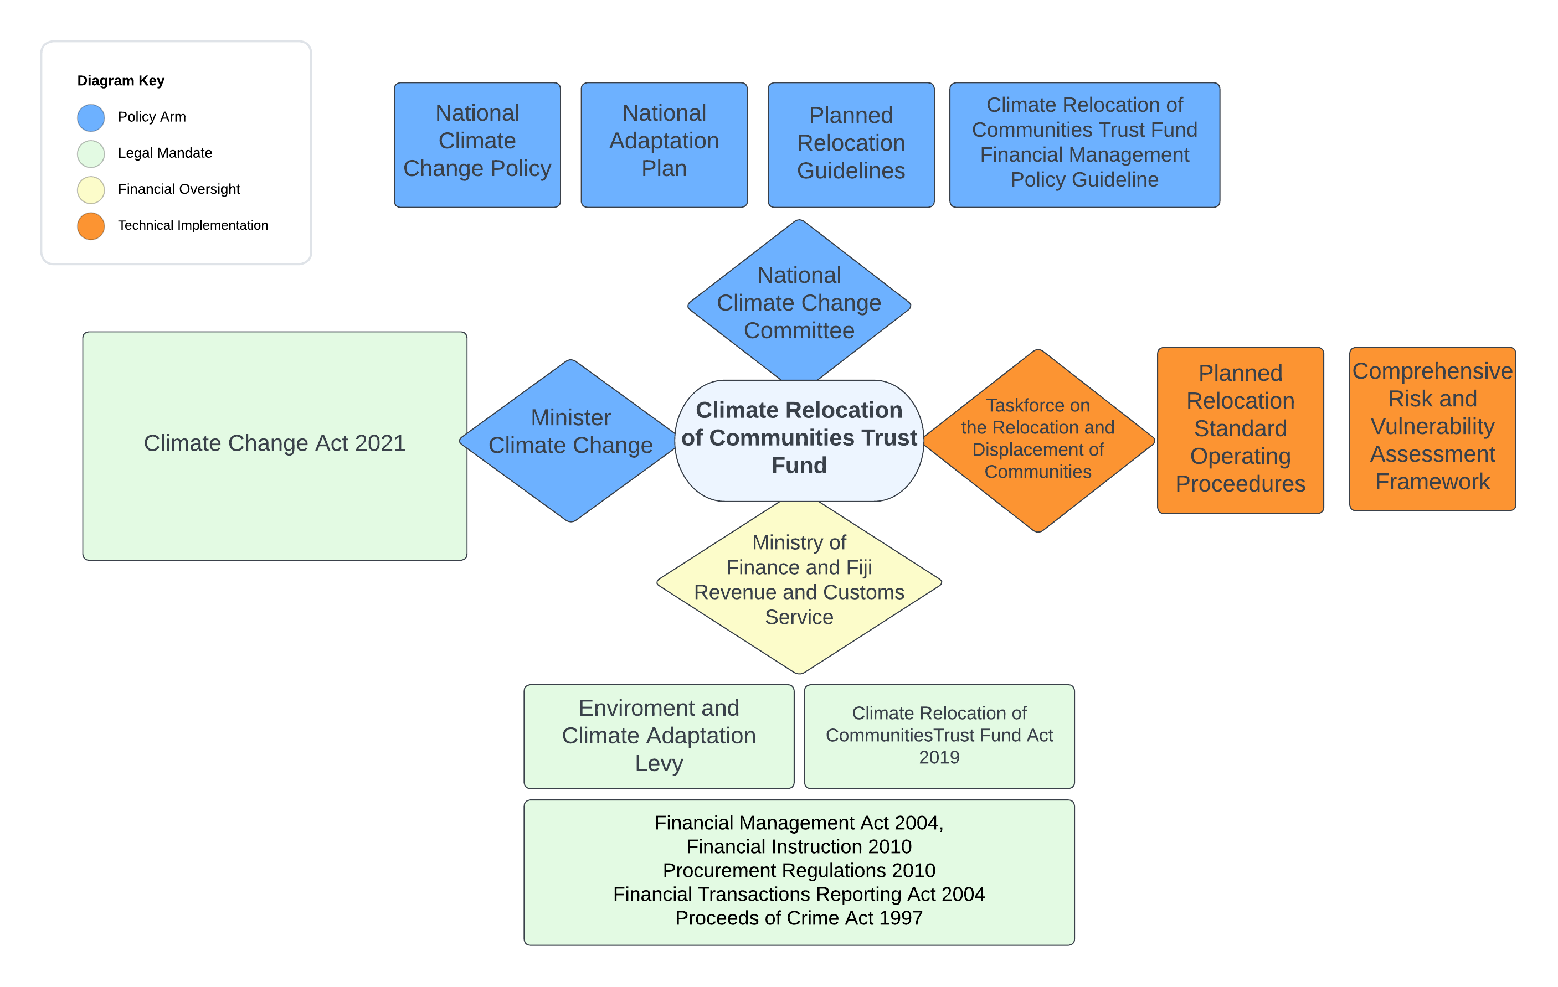
A National System for Addressing specific Loss and damage issues

